Slide 1
Nuclear Fuel Performance
NE 533 Spring 2025

Slide 2
Last Time
Class intro/housekeeping
Intro to fuel performance as a three-pronged concept:
heat generation and delivery to coolant; fuel operation without problems; fuel behavior during accidents
Uranium is combined with O, C, N, transition metals for a variety of fuel types
UO2: ceramic, commercial reactor fuel, light water reactors

Slide 3
Uranium Dioxide (UO2)
Reference fuel for nuclear power industry
Single phase, fluorite structure
Fabrication via sintering UO2 powder into pellets
Water coolant
Pellets are stacked inside Zircaloy cladding tubes

Slide 4
Uranium Dioxide (UO2)
Good Characteristics
Very high melting point, about 2800 C
Maintains a stable fluorite phase up to melting
Very compatible with Zircaloy clad (no interaction zones forming/no FCCI)
Relative stability in water
Reasonably radiation resistant
no amorphization
Can incorporate a large number of fission products as substitutional defects

Slide 5
Uranium Dioxide (UO2)
Bad Characteristics
Brittle (thermal stress fractures, fragmentation)
Poor thermal conductivity
Properties very sensitive to stoichiometry
Limited linear heating rates
Non-negligible thermal expansion/swelling
Higher stored thermal energy than other fuel materials

Slide 6
Uranium Dioxide (UO2)
Critical Phenomena
Thermal conductivity (and degradation)
Fission gas release, leading to pressure increase inside the cladding
Fuel fragmentation and relocation under transients
Bambooing creating stress concentrations
All operational reactors in US utilize UO2

Slide 7
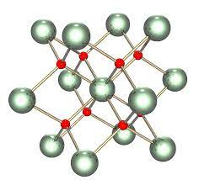
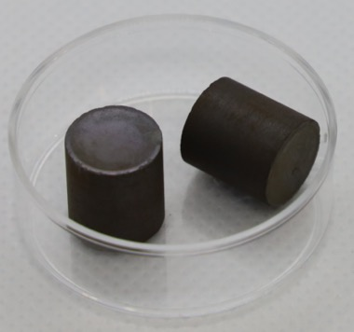
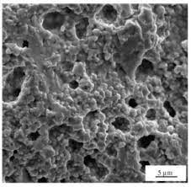
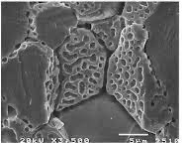
Uranium Dioxide (UO2)
The majority of this course will focus on UO2 fuels and the associated reactor materials for UO2 application in LWRs
Material properties, challenges, and phenomena associated with these systems
We will get to some discussion of advanced fuel concepts later in the term

Slide 8
Reactor systems

Slide 9
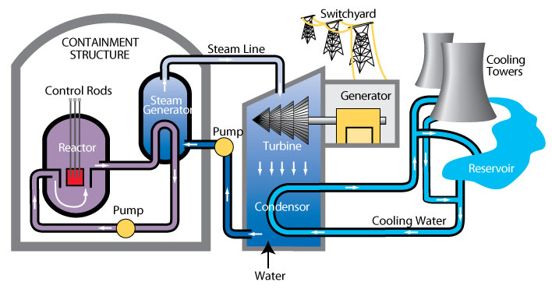
Heat removal systems
Primary mechanism to remove heat directly from fuel is a coolant
Various coolant types, mainly water
Primary loop water runs through the core, transporting heat generated by the fuel, to a steam generator in a secondary water loop
Steam drives a turbine, generating electricity
A tertiary water loop helps to condense residual steam from the secondary loop via cooling towers and a water reservoir

Slide 10
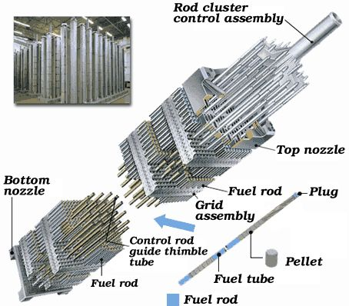
Light Water Reactor Core Design
An LWR core is comprised of fuel assemblies
Each assembly contains a grid of fuel pins
In typical commercial LWR fuel designs, a 17x17 grid
Some pins are replaced by control rods
Water flows from bottom to top

Slide 11
LWR Fuel Pins
LWR fuel pins are comprised of a hollow Zircaloy tube
This is the cladding
Zircaloy is a type of Zr alloy
Inside the cladding are stacked UO2 pellets
Each pellet is a cylinder about 1 cm in diameter and 1.5 cm in height

Slide 12
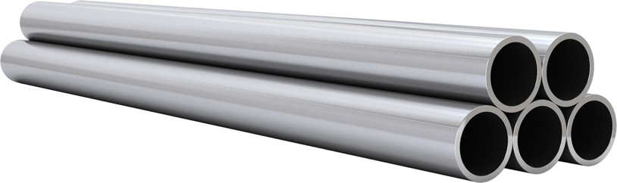
Most fuel designs employ some type of cladding
The primary focus of the cladding is to separate the fuel from the coolant
Fuel contains radioactive fission products
Avoids corrosion of the fuel by the coolant
Keeps the fuel together, not blocking coolant flow
The cladding should be thin and have a high thermal conductivity, so it doesn’t trap any of the heat produced by the fuel
Cladding should also be neutron transparent

Slide 13
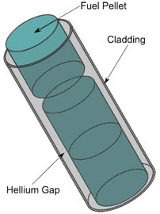
Fuel/Cladding Gap
Fuel swells during reactor operation and the cladding creeps down around the fuel
To avoid/limit both chemical and mechanical interaction, the pellet radius is smaller that the inner radius of the cladding
In LWRs, the gap is filled with He gas, significantly impacting the heat transport
In metal fuels, the gap is filled with liquid sodium, so there is little impact on the heat transport

Slide 14
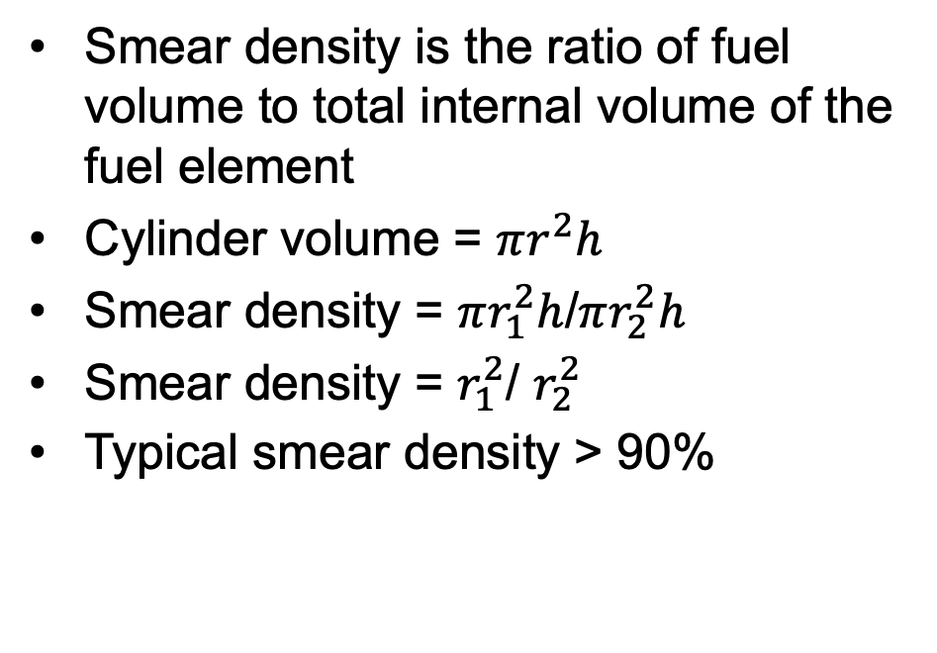
Smear Density
Smear density is the ratio of fuel volume to total internal volume of the fuel element
Cylinder volume = $πr^{2}h$
Smear density = $πr_{1}^{2}h$/$πr_{2}^{2}h$
Smear density = $r_{1}^{2}$/ $r_{2}^{2}$
Typical smear density > 90%
r1
h
r2

Slide 15
Cladding material selection
Cladding must be compatible with the coolant, reasonably compatible with the fuel, have good thermal conductivity and reasonable radiation resistance
Zirconium is used because of its
Low neutron cross section
Corrosion resistance in 300 C water
Resistance to void swelling
Adequate mechanical properties
Good thermal conductivity
Affordable cost
Available in large quantities
Other cladding materials in use include
Stainless steel
Silicon Carbide
Ferritic-Martensitic steels like Fe-Cr and Fe-Cr-Al
Oxide dispersion strengthened (ODS) ferritic steels

Slide 16
Reactor Systems Wrap-up
All reactors have basic requirements they must meet
An approach to remove the heat from the fuel, a method to convert heat to electricity, an approach to prevent radioactive products from leaving the fuel, a method to cycle the fuel, containment in case something goes very wrong
Typically, the “fuel system” consists of the fuel itself, the gap, the cladding
primary coolant can also be included, or at least impacts of the coolant
Cladding is the primary containment, and its integrity maintains safe operation
LWRs have fuel pellets, a He gap (bond), and Zircaloy cladding

Slide 17
fuel fabrication

Slide 18
Fabrication Process

Slide 19
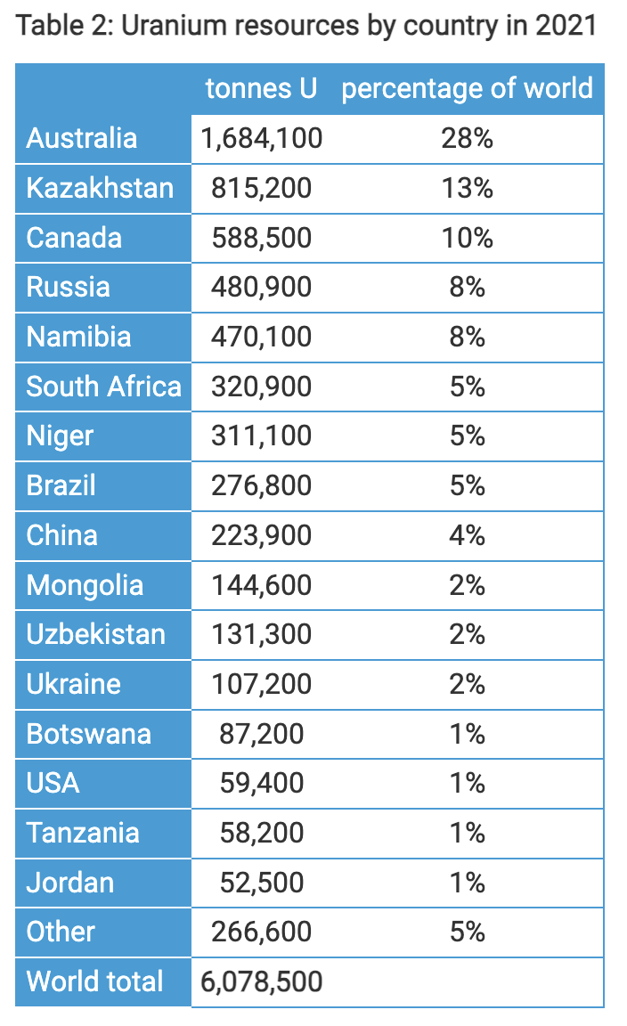
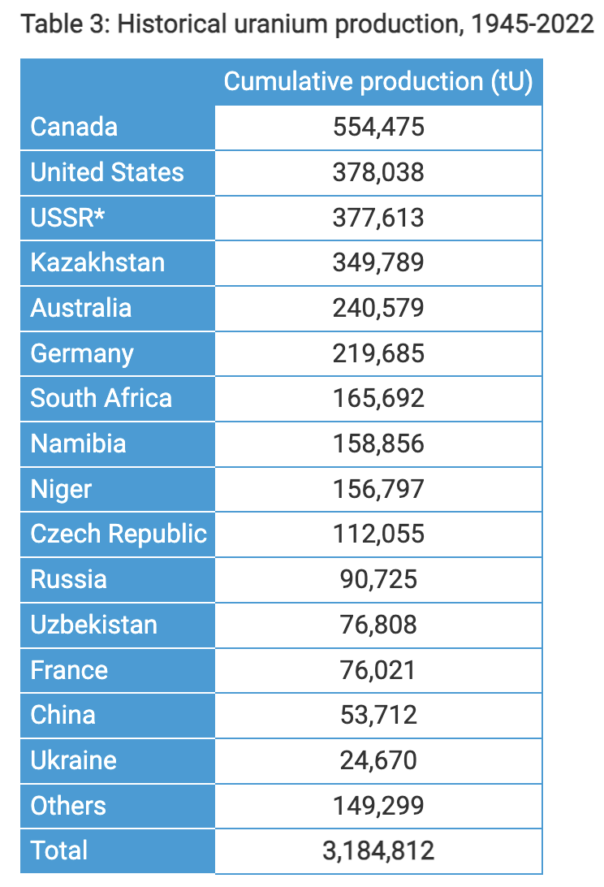
Global Uranium Resources
world-nuclear.org

Slide 20
Uranium mining/processing
Uranium ores are normally processed by grinding the ore materials to a uniform particle size and then treating the ore to extract the uranium by chemical leaching
The milling process commonly yields dry powder-form material consisting of “yellowcake”, which was historically referred to as U₃O₈
Most modern uranium recovery facilities produce a yellowish compound comprised mostly of uranyl peroxide dihydrate

Slide 21
Conversion
Uranium enrichment requires uranium as uranium hexafluoride (gaseous state), which is obtained from converting uranium oxide to UF₆
Uranium oxide can be reduced by hydrogen to produce UO2
U₃O₈ + 2H₂ ===> 3UO₂ + 2H₂O
The oxide is then reacted with hydrogen fluoride to form uranium tetrafluoride (UF4)
UO₂ + 4HF ===> UF₄ + 2H₂O
The tetrafluoride is then fed into a fluidized bed reactor with gaseous fluorine to produce uranium hexafluoride, UF6
UF₄ + F₂ ===> UF₆

Slide 22
Enrichment
Natural uranium only contains 0.7% U-235, and therefore must be enriched to obtain suitable fissile material for fuel (for most reactors)
The difference in mass between U-235 and U-238 allows the isotopes to be separated and makes it possible to enrich the percentage of U-235
The capacity of enrichment plants is measured in terms of 'separative work units' or SWU
Two main enrichment processes
Gaseous diffusion: 2500 kWh per SWU
Centrifuge: 50 kWh per SWU

Slide 23
Enrichment
Gaseous diffusion
Pushes UF6 through porous membrane
U235-F6 travels slightly faster
First Gen. technology, historical, but now outdated
Centrifuge
gas is placed in a gas centrifuge cylinder and rotated at a high speed
strong centrifugal force, heavier gas molecules move towards the outside of the cylinder

Slide 24
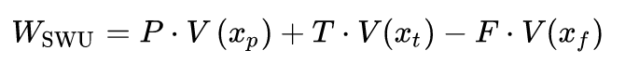
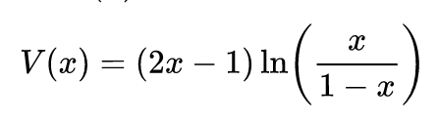
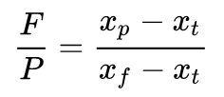
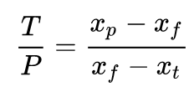
SWUs
The work W_{SWU} necessary to separate a mass F of feed of assay x_{f} into a mass P of product assay xp and tails of mass T and assay x_{t} is given by:
V is the value function:
The feed to product ratio (F/P) is given by the expression
The tails to product ratio (T/P) is given by the expression
The same amount of separative work will require different
amounts of energy depending on the efficiency of the separation technology

Slide 25
High Enriched Uranium
One ton of natural uranium feedstock might end up: as 120-130 kg of uranium for power reactor fuel, as 26 kg of typical research reactor fuel, or conceivably as 5.6 kg of weapons-grade material
The curve flattens out so much because the mass of material being enriched progressively diminishes, so requires less effort relative to what has already been applied to progress a lot further in percentage enrichment

Slide 26
Enrichment
Enrichment accounts for almost half of the cost of nuclear fuel and about 5% of the total cost of the electricity generated
It is also the main greenhouse gas impact from the nuclear fuel cycle where the electricity used for enrichment is typically generated from coal or natural gas
However, it still only amounts to 0.1% of the carbon dioxide from equivalent coal-fired electricity generation if modern gas centrifuge plants are used

Slide 27
Fabrication Process

Slide 28
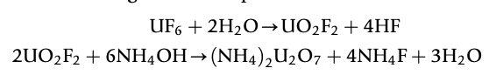
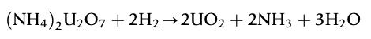
Powder Processing
Uranium typically arrives at a fuel manufacturing plant as uranium hexafluoride (UF₆) and needs to be converted to uranium dioxide (UO₂) prior to pellet fabrication
An example conversion process injects UF₆ into water to form a UO₂F₂ particulate slurry, ammonia (NH3) is added to this mixture and the UO₂F₂ reacts to produce ammonium diuranate (ADU, (NH₄)2U₂O₇), after which the slurry is filtered, dried and heated in a reducing atmosphere to pure UO₂
A reducing atmosphere is one in which oxidation is prevented by removal of oxygen and other oxidizing gases, and which may contain actively reducing gases such as hydrogen

Slide 29
Powder/Pellet Processing
The UO₂ powder may need further processing or conditioning before it can be formed into pellets:
Homogenization: powders may need to be blended to ensure uniformity in terms of particle size distribution and specific surface area
Additives: U₃O₈ may be added to ensure satisfactory microstructure and density for the pellets and other fuel ingredients, such as lubricants, burnable absorbers (e.g., gadolinium) and pore-formers may also need to be added
UO₂ powder is fed into dies and pressed biaxially into cylindrical pellet form using a load of several hundred MPa
Pellets are then sintered in a heating furnace
Sintering is the process of compacting and forming a solid mass of material by heat or pressure

Slide 30
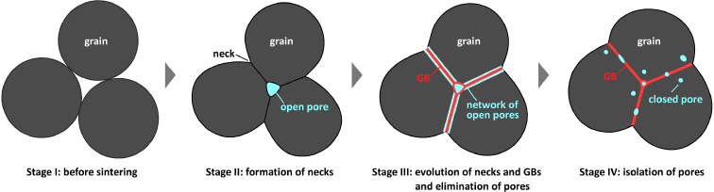
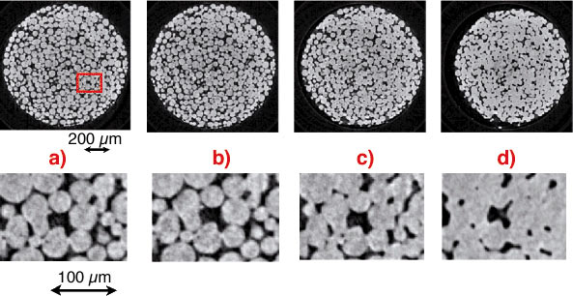
Sintering Process
During sintering, atoms in the materials diffuse across the boundaries of the particles, fusing the particles together and creating one solid piece
The final fuel pellets are nearly fully dense with a uniform microstructure: grain size ~ 10 μm; pore size ~ 3 μm; density ~ 95 - 99%
The sintered microstructure (grain size and porosity) has a strong impact on the fuel evolution, and this processing stage can be tailored to meet microstructural needs

Slide 31
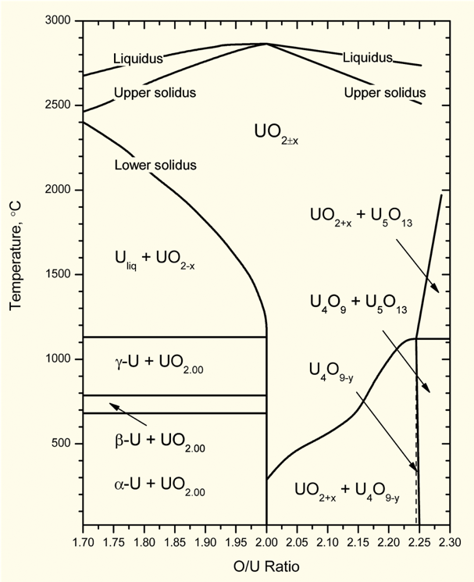
Fuel strictly manufactured to be UO₂
Fuel fabricated to be nearly stoichiometric; i.e., UO_{2.00±}
Structure stable to T_{melt}
Maximum T_{melt}
O/M ratio varies slightly during irradiation
Large deviations from stoichiometry relevant to
Fabrication
Fuel behavior
Reprocessing
Accident conditions during dry storage or shipment of used nuclear fuel

Slide 32
Rods and Assemblies
The fuel pellets are assembled in fuel rods and then put together in fuel assemblies
Designs dictate that the pellet-filled rods have a precise physical arrangement in terms of their lattice pitch (spacing), and their relation to other features such as water (moderator) channels and control-rod channels
Physical structures for holding the fuel rods are therefore engineered with extremely tight tolerances and are largely constructed of steel and zirconium alloys

Slide 33
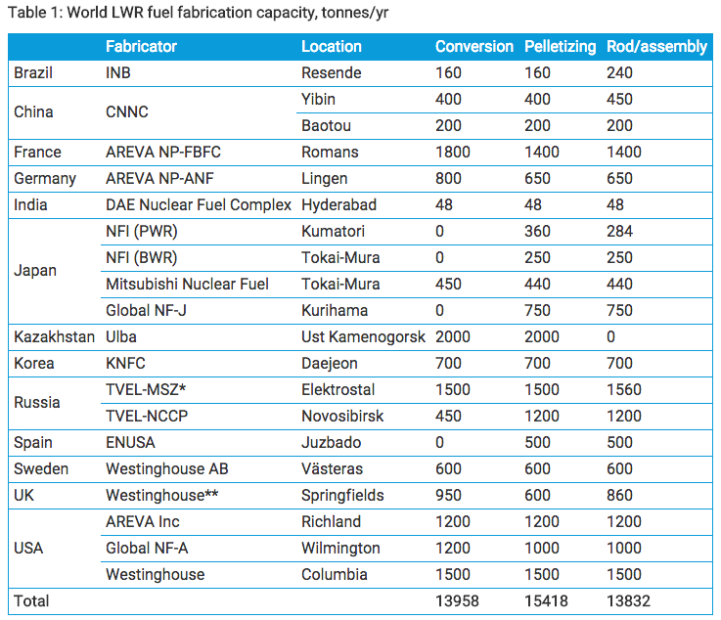
Global Fuel Fabrication
LWR fuel pellets and rods/assemblies are manufactured in a number of countries
USA, Russia, Kazakhstan, and France are leaders
There is a growing need for HALEU
High assay low enriched uranium
Uranium with 19.7% enrichment

Slide 34
Fuel Fabrication Summary
Mining -> Processing -> Conversion -> Enrichment -> Powder -> Compaction/Sintering -> Rod/Assembly
U₃O₈ must be converted to UF₆ for enrichment, which is then converted to UO₂ powder for pellet manufacture
UO₂ microstructure from fabrication strongly impacts fuel performance

Slide 35
Heat Generation

Slide 36
Fission basics
Impinging neutron of a given energy
Neutron energy determines cross section which determines probability of fission event
Neutron + Target Nucleus -> Two fission products, 2-3 neutrons
Fission releases around 210 MeV of energy
170 MeV to fission fragments
2 MeV per neutron
7 MeV gamma rays
Balance radioactive decay

Slide 37
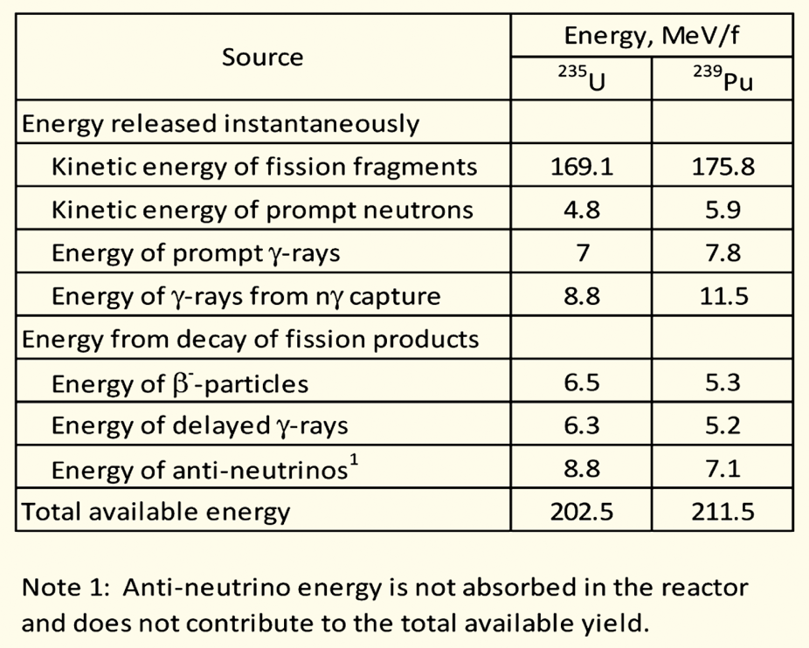
Energy release with different nuclei
Energy release is effectively agnostic with regards to the fissioning species
Comparing U-235 with Pu-239 on the right
Pu releases about 9 MeV more usable energy per fission
Less than a 5% difference
Partition of energy is largely identical as well

Slide 38
Fission product yield
Regardless of fissioning isotope, fission product yields are effectively the same, in this double hump distribution
One broad peak centered around A=95, the other around A=135
Examples:
Mo (Z=42, A=96)
Cs (Z=55, A=133)

Slide 39
Fission Product Yields

Slide 40
Summary
UO2 Good characteristics:
high melting point, single phase, cladding compatibility, radiation resistance, stability in water
UO2 Bad characteristics:
brittle, low thermal conductivity, limited power density, high burnup swelling
All reactors have basic requirements they must meet
Typically, the “fuel system” is thought to consist of the fuel itself, the gap, the cladding, and the coolant
Mining -> Processing -> Conversion -> Enrichment -> Powder -> Compaction/Sintering -> Rod/Assembly
UO₂ microstructure from fabrication strongly impacts fuel performance

